Slide 1

Supply Chain IoT Tile and
Smart Container
Curiosity Gym
<number>
Notes:
<number>

Slide 2
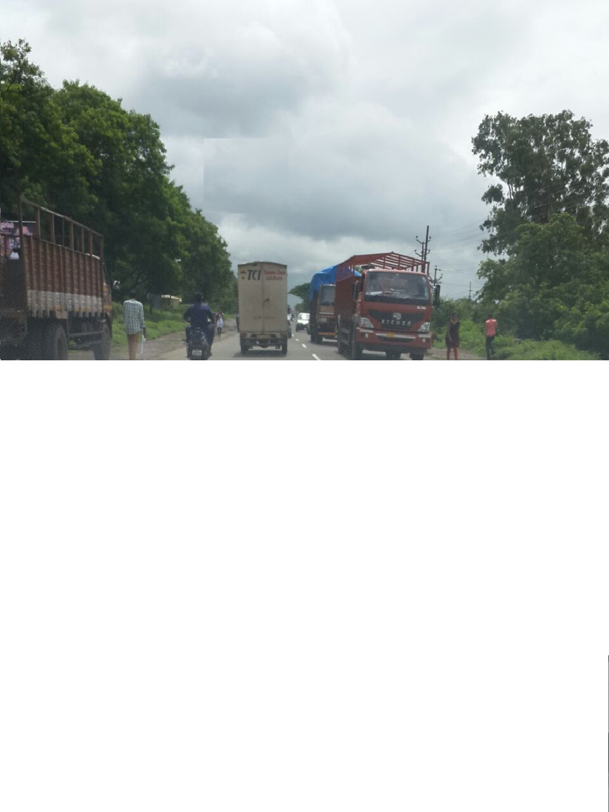
Trucks coming here, Vans going there…
Why are all these trucks and vans going here and there.
<number>
Notes:
<number>

Slide 3
Project Goal:
Product Replenishment for Consumer using Smart Box
and Model Supply Chain Optimization
How:
Smart Container triggers message when low
Prompt delivery to customer before supply runs out
Visibility to factory of aggregate latent demand
Just in time delivery to distribution center
Upsell and cross sell possibility to supplier with analytics over time
<number>
Notes:
<number>

Slide 4
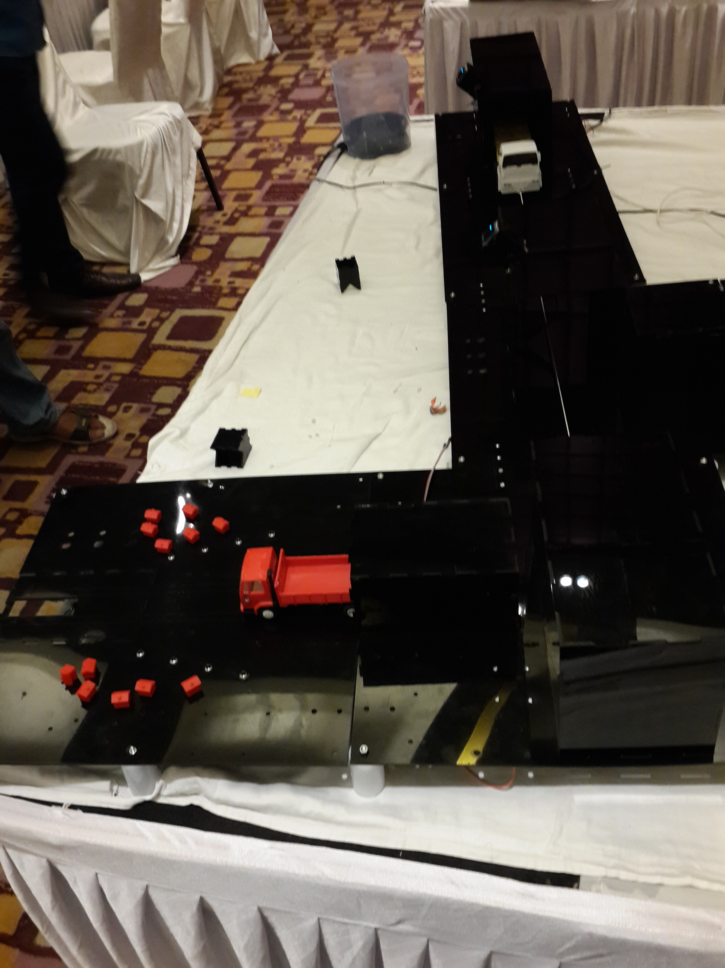
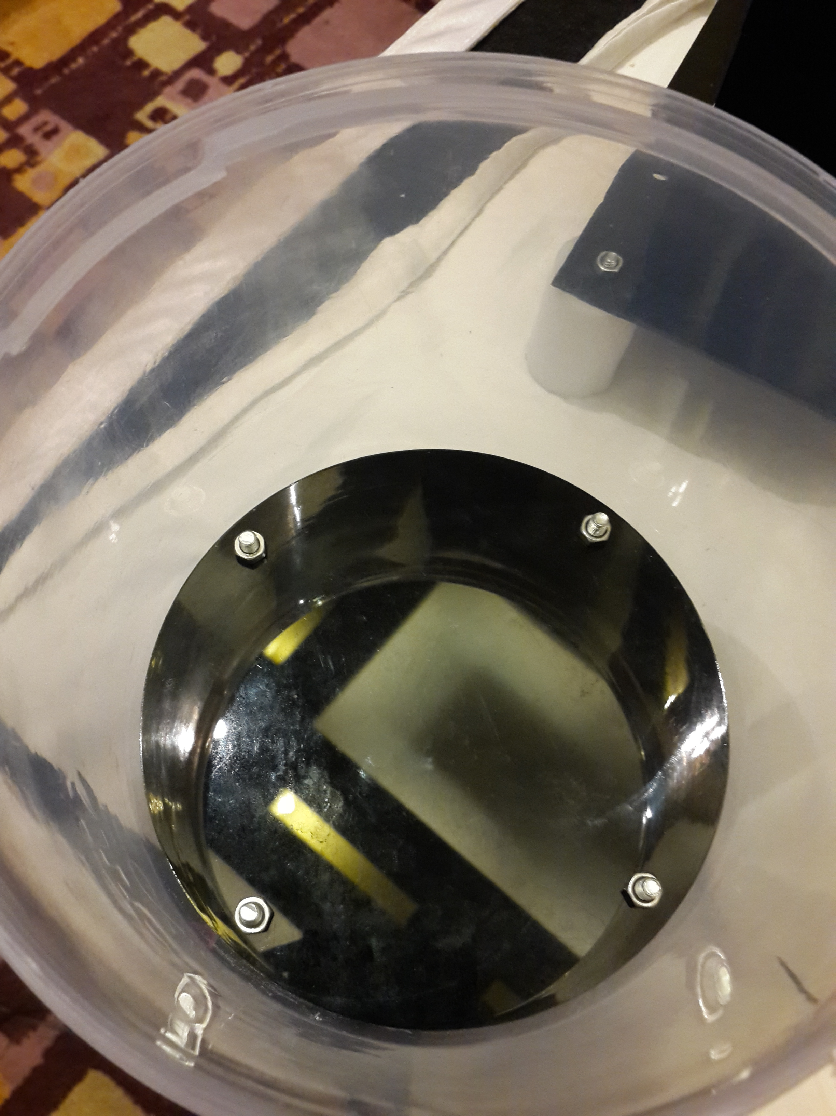
<number>
Notes:
<number>

Slide 5
How are these goals achieved?
Supplier (FMCG) gives box to track load to consumer for free
Load sensor in Box that triggers at replenishment level to nearest provision store registered
HQ keeps track of aggregate retailer and distributor demand and co-ordinates real time logistical delivery based on demand and supply
<number>
Notes:
<number>

Slide 6
Message Flow
Box Needs replenishment ->
Retailer replenishment
On many pent up demand ->
Distributor replenishes retailer
On 100x Distributor demand ->
Factory replenishes distributor
<number>
Notes:
<number>

Slide 7
Supply Chain IoT Tile Architecture
Edison Board in Consumer Box with Load Limit Switch
Arduino Boards for Motor Control. IR sensors used to detect and trigger
vehicle stops/resumes.
3. Destination. Vehicle motion simulated with push/pull pulleys on track,
OLEDS that display status of consumer demand or
Distributor/factory/retailer loading/vehicle status controlled by
Inter process communications
4. Charting of Demand and supply and visibility to HQ in real time using EnableIot.
5. MQTT publish subscribe of messages to coordinate flow
<number>
Notes:
<number>

